Slide 1

First Android Application
This Photo by Unknown Author is licensed under CC BY-NC
MAC220

Slide 2
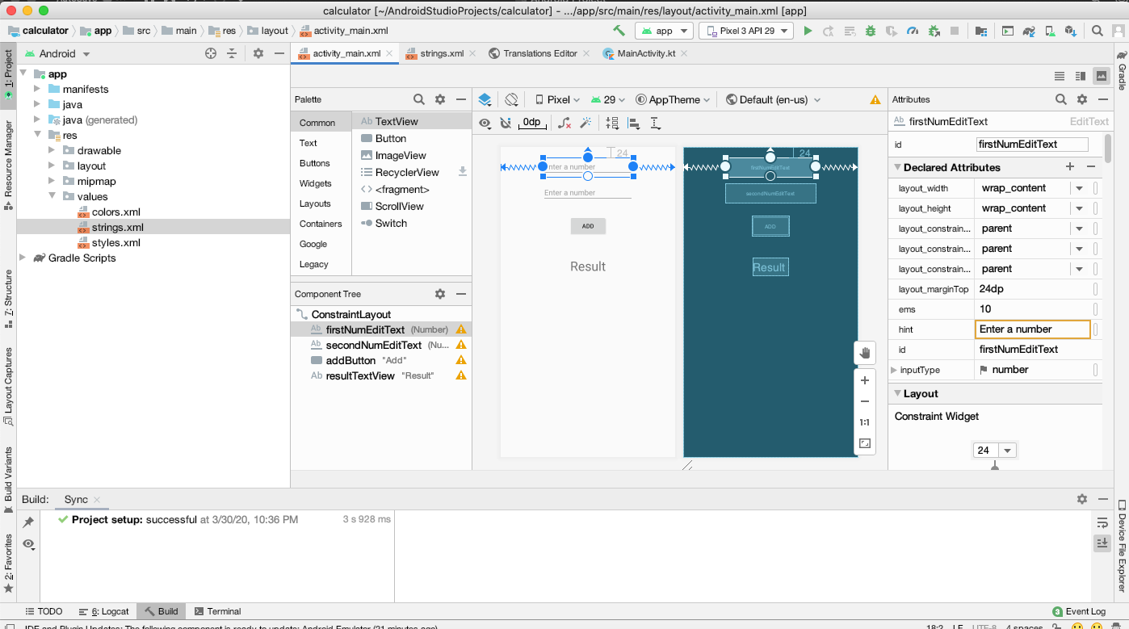








Navigating in Android Studio

Slide 3
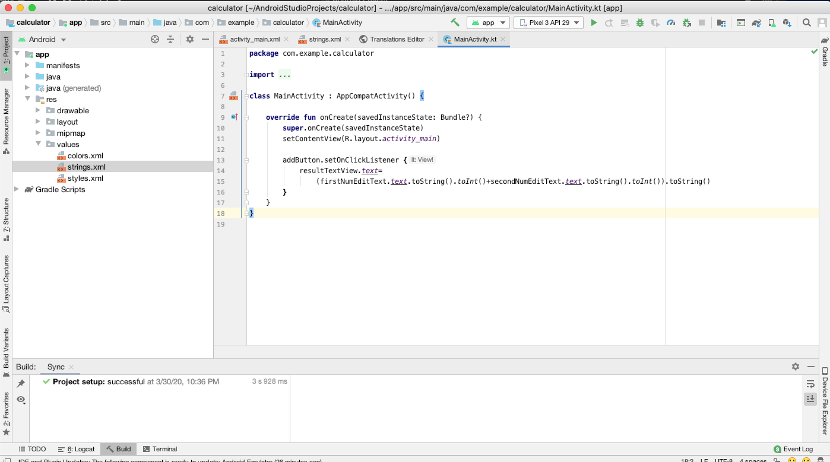








Slide 4
Laying out the UI
activity_.xml (snake_case)
Views – building blocks
Widgets – text, image, buttons etc
Every widget is instance of a view
ViewGroup – contains and arranges other views
ConstrainLayout

Slide 5











Linear layout
<?xml version="1.0" encoding="utf-8"?>
<LinearLayout xmlns:android="http://schemas.android.com/apk/res/android"
android:layout_width="match_parent"
android:layout_height="match_parent"
android:gravity="center"
android:orientation="vertical">
<TextView
android:layout_width="wrap_content"
android:layout_height="wrap_content"
android:padding="24dp"
android:text="@string/question_text"/>
<LinearLayout
android:layout_width="wrap_content"
android:layout_height="wrap_content">
<Button
android:id="@+id/true_button"
android:layout_width="wrap_content"
android:layout_height="wrap_content"
android:text="@string/true_button"/>
<Button
android:id="@+id/false_button"
android:layout_width="wrap_content"
android:layout_height="wrap_content"
android:text="@string/false_button"/>
</LinearLayout>
</LinearLayout>

Slide 6
String resources & View objects
Default strings file res/values/strings.xml
Used for localization
Translation editor to create values
AppCompatActivity – provides support for older versions of android

Slide 7
Wiring up widgets
Get reference to the view objects
Activity.findViewById(Int)
trueButton = findViewById(R.id.true_button)
Set listeners on those objects to respond to user actions
trueButton.setOnClickListener{ code goes here }

Slide 8
View binding
Since Android Studio 3.6
Enable view binding using build.gradle (Module: AndroidSample.app) file
android {
buildFeatures {
viewBinding true
}
For a layout file named activity_main.xml, binding class generated by Android Studio will be named ActivityMainBinding
import com.example.androidsample.databinding.ActivityMainBinding

Slide 9
View binding
class MainActivity : AppCompatActivity() {
private lateinit var binding: ActivityMainBinding
override fun onCreate(savedInstanceState: Bundle?) {
super.onCreate(savedInstanceState)
binding = ActivityMainBinding.inflate(layoutInflater)
setContentView(binding.root)
}
….

Slide 10
Making Toasts
Pop-up message – Toast
makeText(context: Context, resId: Int, duration: Int)
Toast.show()

Slide 11
App lifecycle
Each application is a separate process
If resources on device are maxed, system will start killing processes
Priority and state
Highest priority
Foreground
Visible
Service
empty
background
Lowest Priority

Slide 12
Activity state diagram
Killed
Active/Running

Slide 13
Activity states
States | In memory | Visible to user | In foreground
nonexistent | no | no | no
Stopped | Yes | no | no
paused | yes | Yes/Partially | no
resumed | yes | yes | yes

Slide 14
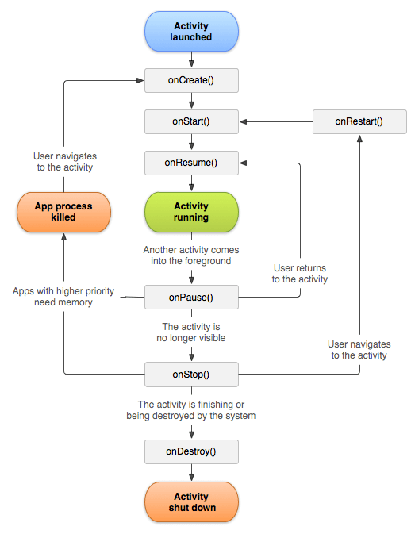
Activity life cycle
This Photo by Unknown Author is licensed under CC BY-SA

